Slide 1
Memo, Letter, and Email
Use and Formatting
Syeda Maryam Zaidi

Slide 2
Classroom Rules
Cell Phones
Cell phone use in class is NOT allowed. Please silence your cell phone.
Attendance & Classroom Behaviour & Civility
Regular attendance, is expected from all students. Your attendance will not be marked after 05 minutes from starting of a lecture.
Ask relevant questions during Q/A session.
Do not make noise during the lecture & Q/A session.
Bring your own books & stationary with you everyday.

Slide 3
Emails, Memos, and Letters
Emails are generally used both within an organization (“in-house”) and outside an organization, when the subject is relatively informal and routine.
Memos are used only for communication within an organization, especially when the subject is more formal, non-routine, and more serious than what you’d write in an email.
Letters are typically sent to recipients outside an organization. Letters might also be used within an organization if the topic is very formal and/or non-routine.

Slide 4


Emails, Memos, and Letters
Emails: Inside and Outside organization
Memos: Inside organization
Letters: Outside organization (usually)

Slide 5
Memo Cue Words Formatting
LINE UP CUE WORD CONTENT AT 1 inch ruler mark
DATE: Written out as month, day, year
TO: Recipient’s name (and, if desired, title)
FROM: Sender’s name (and, if desired, title) and initials
SUBJECT: One-Line “Headline”

Slide 6
About Capitalization in Formatting
You can capitalize ONLY the first letter of the MAIN/MAJOR words, if you know how to identify these.
Several of these memo examples show the cue words and subject line in ALL caps. This avoids the hassle of trying to identify main/major words. Be aware that two styles exist.

Slide 7
Memo Cue Words Formatting Example # 1
Capitalizing only first letter of main/major words.
Date: September 30, 2015
To: Ray Charles, Marketing Manager
From: Bruce King, Events Manager BK
Subject: Conference Planning

Slide 8
Memo Cue Words Formatting Example # 2
DATE: September 30, 2015
TO: Ray Charles, Marketing Manager
FROM: Bruce King, Events Manager BK
SUBJECT: CONFERENCE PLANNING

Slide 9
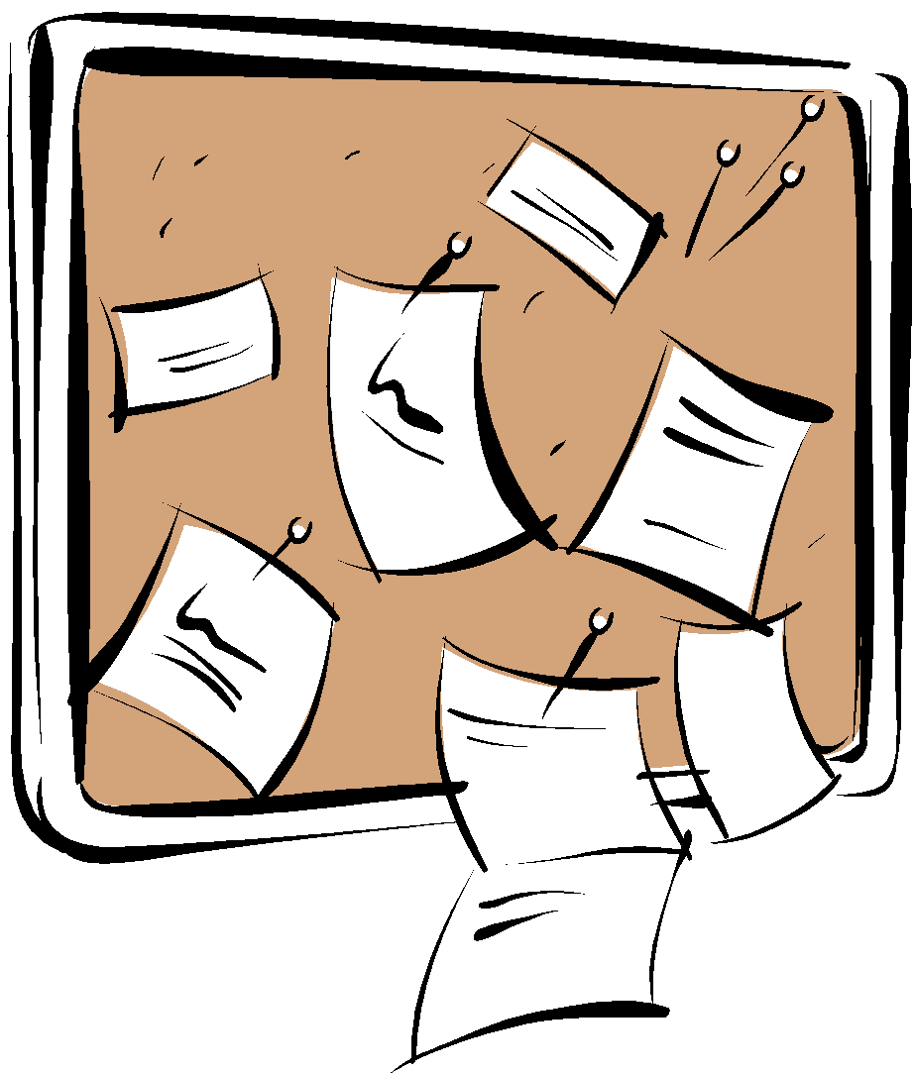

MEMO FORMATTING
See the How to Format a Memo Document.

Slide 10
MEMO FORMATTING
You can view this video on composing and writing a memo.

Slide 11

Letter Formatting
Letter formatting is very different from memo formatting.
You will use letter formatting for the Request and Response Letter Assignments.
The Request and Response Letter Examples demonstrate both how to use the direct strategy and how to write a list with parallel structure.

Slide 12

Letter Formatting
Before you write your Request and Response Letter Assignments, refer to this PowerPoint again.
Don’t create a “LEMO,” which is a combination letter (LE) and memo (MO) mutant. ;)

Slide 13

Business Letterhead
Business Letterhead typically includes company name, address, phone, email, and company web address at the top of the page. Sometimes the address can be placed at the very bottom)

Slide 14
Letter Formatting
Please put the Subject Line ABOVE the Salutation (the Dear Mr. ___ : Dear Ms. ___ : part), not below.
Both locations are acceptable, but BSTEC 110 Company’s “style manual” requires it ABOVE the salutation, to avoid breaking up letter “flow.” ;)

Slide 15
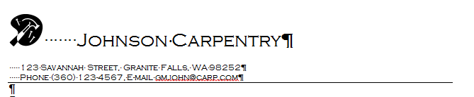
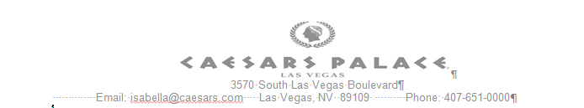

Letterhead Examples

Slide 16
Request-Response Letters Assignment Packet has more Details
Spell out month. Use month, day, year order. May 1, 2015
If you have room, put the JOB TITLE on line 2 of the inside address, and the company name on Line 3.
It’s okay to combine name and job title on line 1 (first choice), or title and company name on line 3 (second choice, as shown).
Always spell out Road, Street, Drive, Avenue, Circle, etc.
It’s okay to abbreviate Boulevard (Blvd.); use a period after abbreviations.

Slide 17
Request-Response Letters Assignment Packet has more Details
FORMATTING LETTERS
On the line underneath the street address, put the City, followed by a comma and then the TWO LETTERS for State abbreviation (WA-no periods!). No comma before zip code.
Put SUBJECT LINE above Salutation, not below.
(Again, both are acceptable, but your BSTEC 110 Company prefers above, to avoid breaking up flow.)

Slide 18

Request-Response Letters Assignment Packet has more Details
Letters have a “complimentary close,” usually “Sincerely,” one blank line after the end of the letter.
Underneath this is the writer’s signature, written above the writer’s typed name. Writer’s title is below the typed name.
Copies to and Enclosure notations are placed below this “signature block.” See How to Format a Business Letter document.
Left-align business documents. Do NOT “justify.”

Slide 19
Formatting Emails
Ms Syeda Maryam Zaidi

Slide 20
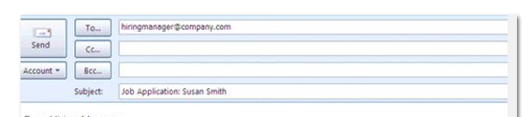
Email Formatting
Email programs have To and Subject boxes for you to fill in. The date is automatically added.
The “look” varies by program.

Slide 21
Email Formatting
As for memos and letters, the Subject Line should be specific, “headlining” what this is about for a busy reader scrolling through hundreds of emails.

Slide 22
Email Salutations
Emails also require Salutations, although these are less formal than a letter’s “Dear Mr. or Ms. ______:”
You can use that, but, unless it’s very formal, you may use Hello, Mr. or Ms. _________, (with a comma) or, if you know the person, “Hello, Nate,” or “Hello, Kara,” instead.
Using “hey,” or “yo,” or no Salutation is NOT professional.

Slide 23
Email Body
As always, a message needs an Introduction, a Body, and a Closing.
Use one blank line between paragraphs to avoid “Wall of Text” Syndrome!

Slide 24
Email Body
The advice is to, if possible, limit email length to what appears on the screen.
Since readers use multiple devices, with different size screens, this can’t always be adhered to.
But consider the average-sized computer monitor screen, and use that as a suggested guideline.

Slide 25
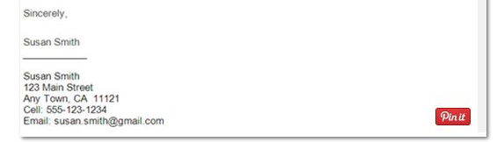
Email Signature Block
Use the complimentary close “Sincerely,” if the email is formal. You can also use “Thank you.”
Most professionals use an automatically inserted “Signature,” which appears at the end of emails.

Slide 26
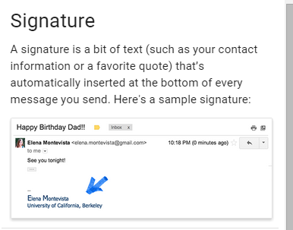
Email Signature

Slide 27




Email Signature
Don’t put TOO much information with your signature. It can look cluttered if you add too much:
Keep it clean.

Slide 28
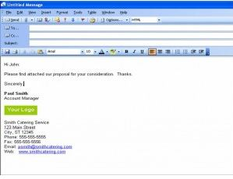
Email Signature

Slide 29
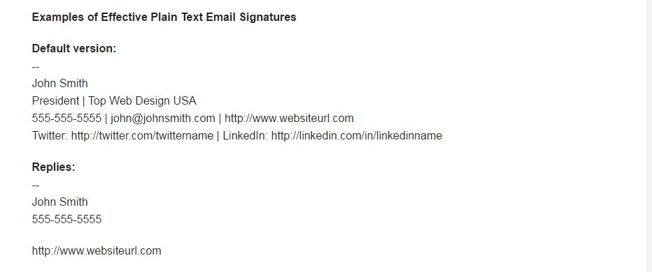
Email Signature

Slide 30
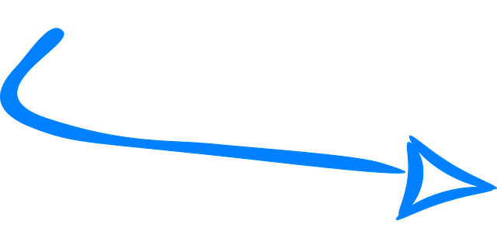
Email Etiquette

Slide 31

O.H.I.O.
Only Handle it Once
How to Handle Multiple Messages Efficiently

Slide 32
Only Handle it Once (O.H.I.O.)
The gist of OHIO is to manage your time and resources efficiently and to reduce clutter.
When handling hard-copy letters or memos for the first time, determine whether it needs action right now, today, tomorrow, this week or month, or whether no action is needed.

Slide 33
Only Handle it Once (O.H.I.O.)
Only Handle it Once applies especially to junk mail, hard-copy, or email, that you can make a fast decision about to delete.
The “rule” is not meant to be taken literally for other mail and email, which should be considered carefully and handled an efficient number of times.

Slide 34
Only Handle it Once (O.H.I.O.)
Only Handle it Once can mean that you set the non-urgent letter, memo, or email aside and then commit time that evening to focus on it.
Some messages might be about large projects, and, obviously, you cannot handle those once and complete the project, while ignoring everything else!

Slide 35
Only Handle it Once (O.H.I.O.)
for Memos and Letters
Sort or file the memo or letter accordingly: “need action soonest” items near at hand; others filed and easily identified (so you don’t forget about them!)
No action needed might be filed for documentation or historical purposes, or recycled or shredded.

Slide 36
Only Handle it Once (O.H.I.O.) for Email
Emails can be overwhelming; you might receive 100s daily at work.
Email “folders” help you to immediately prioritize and “file” emails to work on right away, today, tomorrow, within the week, etc.
Different email providers offer their own style of folders.

Slide 37
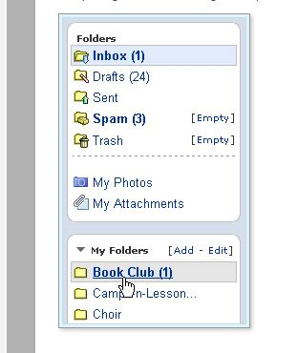
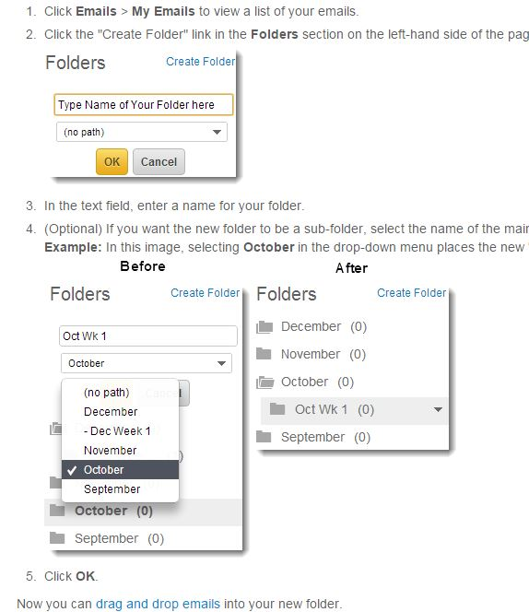
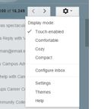
Only Handle it Once (O.H.I.O.) for Email

Slide 38
O.H.I.O or H.I.O.O?
By the way, if you think that Only Handle it Once has a misplaced modifier, you are correct.
But Handle It Only Once (HIOO) is just not as catchy. :)

Slide 39
End of Memo, Letter, and Email
Formatting Presentation
Ask relevant questions

